Slide 1


Course feedback in Spark
– presentation for teachers
March 2022
Susanna Taimitarha, Mikaela Krohn

Slide 2

Background
Our old course evaluation system disappeared with Oodi, and is replaced by Spark (Studyo OY).
The courses in P3 are the first courses to be evaluated in the new program (pilot). They are planned to be evaluated in the last week of March.
The pilot evaluation will be open for a week, preliminary dates are 25 March – 1 April.
Spark - feedback service

Slide 3

What is new?
Spark is located in Moodle
You can see all upcoming, ongoing and past evaluations
You can add own questions from a shared question bank
You will get the results in numbers and graphs
You are expected to give respons on feedback
Instructions available in English on our Spark web page
Spark - feedback service

Slide 4
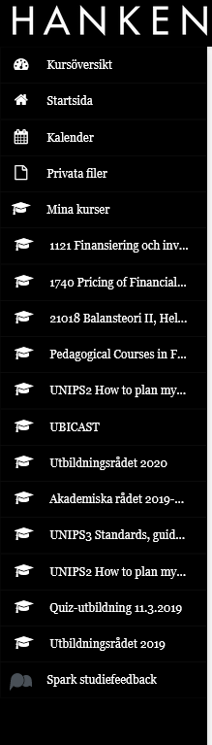
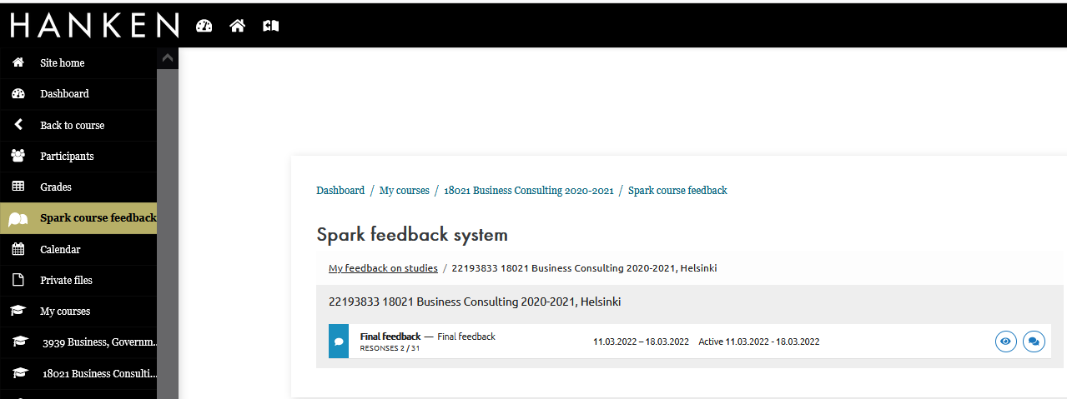
Spark is located in Moodle
Spark is installed as a part of Moodle. You will find it last in the Moodle’s main menu and under the menu for each course.
Spark uses the language selection from Moodle.

Slide 5
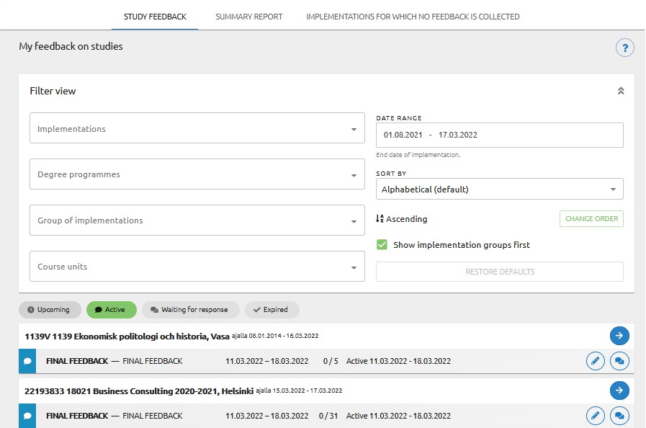
Upcoming, active and evaluations waiting for response
In the list view you can see all your courses and respective questionnaires. If the course has more than one teacher, all teachers can see the survey.
You can filter and search for surveys in the list.

Slide 6
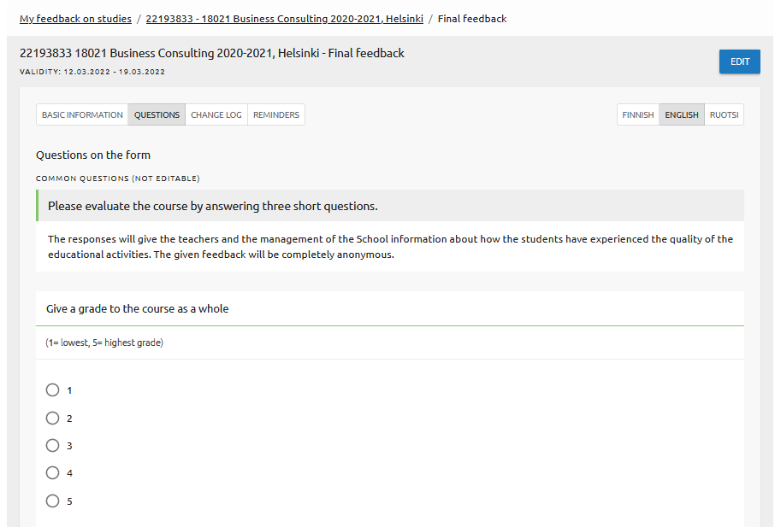
Add own questions from a question bank
There are Hanken’s five general questions in each survey
You can add questions from the question bank to the end of the survey. Questions in the question bank are maintained by your Spark administrator. For new questions contact teachinglab@hanken.fi Number of questions is determined by the administrator.

Slide 7
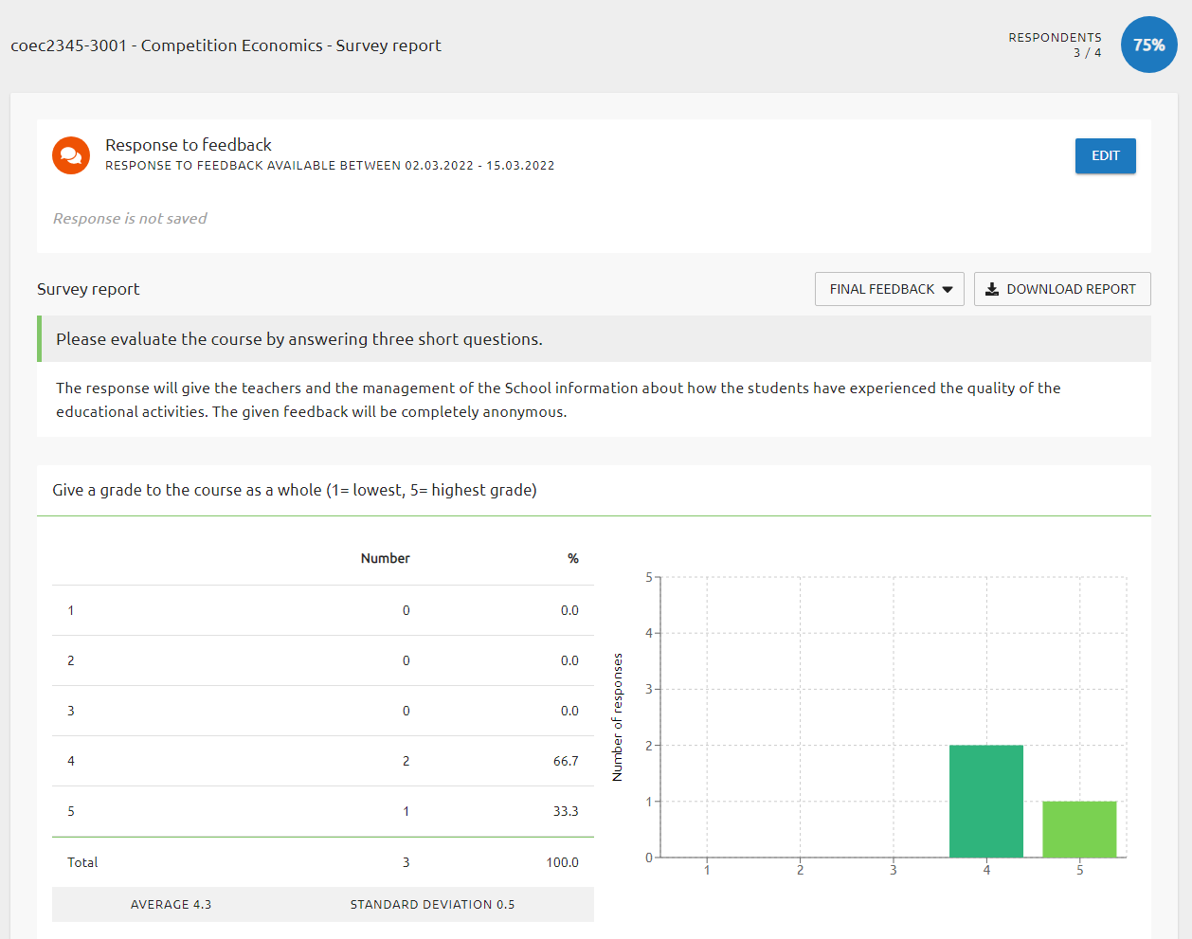
Summary report 1/2
You will see the course name and code, number of replies and response rate in the upper part of the page.
Next you can write, edit and publish the teacher's response.
Below you can see the distribution, averages and standard deviation of responses.
You can download the report as an excel-file.

Slide 8
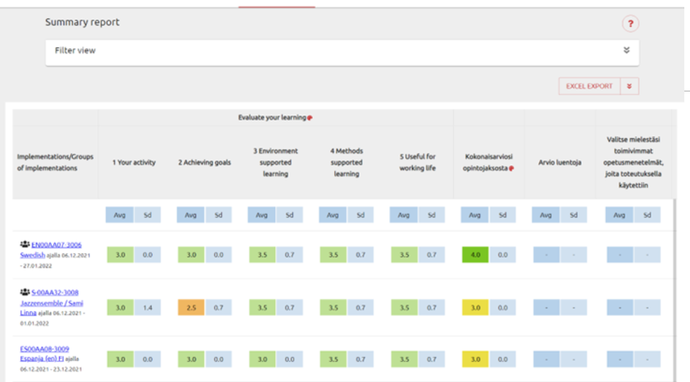
Summary report 2/2
Use the Summary report view to see all past final feedback surveys and their results.
Averages and deviations are available for all questions for each survey.
Summary report can be exported to excel.

Slide 9

A few words on giving response on course feedback
Look for patterns in the students' feedback
Focus on issues about student learning – feedback is not a question of teacher popularity or performance
Avoid responding in affect – take a moment to get over hurtful/impolite comments (everyone gets them)
Responding to feedback does not mean that you have to change something in your teaching – responding is part of academic professionality and our integrity towards the students.
If you are planning to change something, you can of course mention that in your response :-)

Slide 10

Upcoming Teaching lab sessions
28.3. 13-14 Wooclap – teacher's experiences
2.5. 14-16 Get to know Learning Design
18.5. 14-16 Hanken Teaching Day
- Theme meeting student special needs in your teaching and student wellbeing.
31.5. workshop on meeting students' special needs (more indepth)

