Slide 2
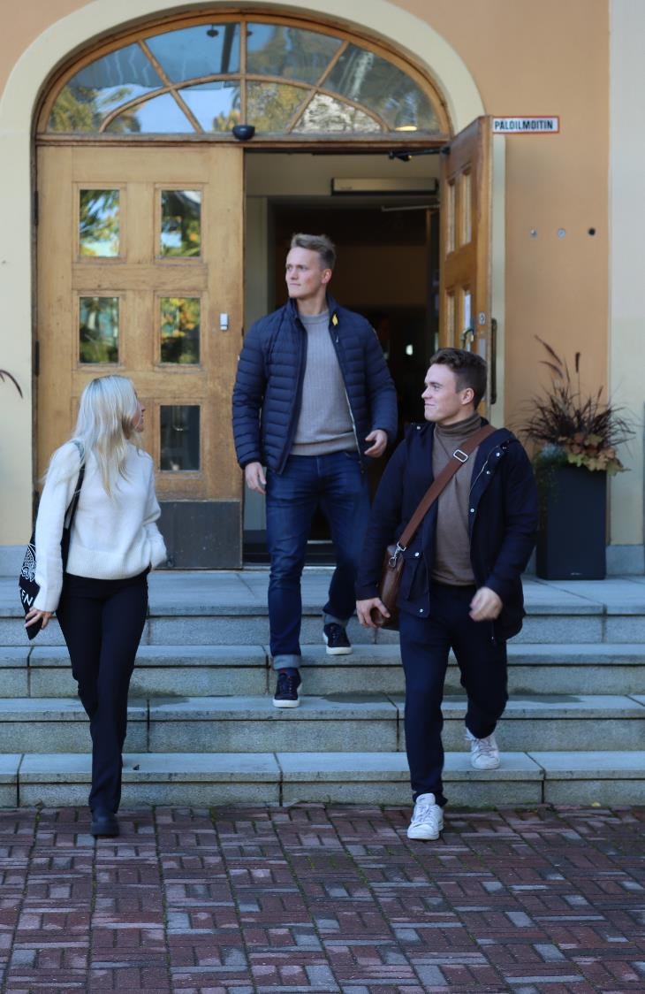
ABOUT HANKEN
Founded in 1909
University status 1927
Comprehensive business school that offers BSc, MSc and PhD in economic sciences as well as executive education (Hanken & Stockholm School of Economics) as well as Hanken Executive MBA (EMBA)
Branch set up in Vaasa in 1980
Turnover 29,3 M€ (2025)
International accreditations: EQUIS, AACSB and AMBA
International rankings: FT Masters in Management (56)

Slide 3
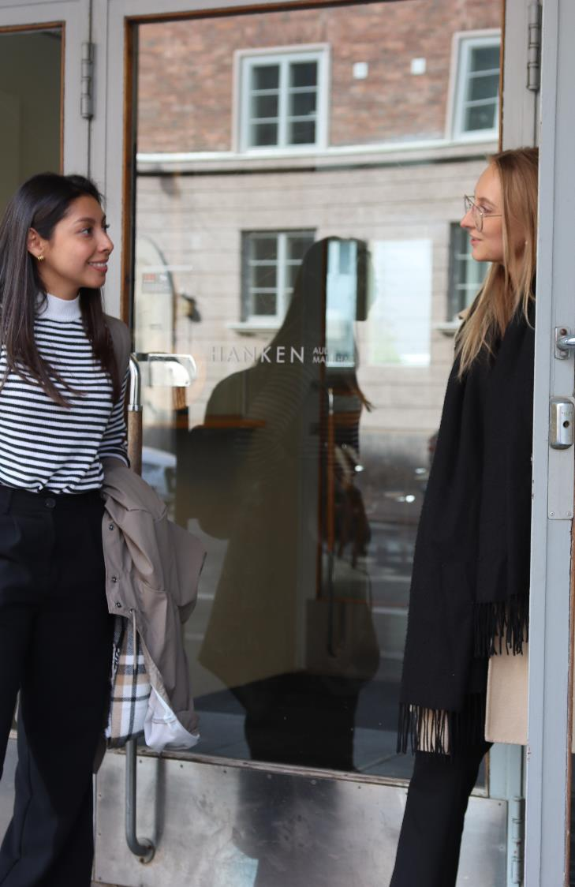
HANKEN TODAY
Teaching in Swedish and English
4 departments and a centre for languages and Business Communication
2 910 students (2025)
  2 778 BSc and MSc students
  132 PhD researchers
  18 % in Vaasa
317 employees (2025)
Finland’s only free-standing business school and one of 13 universities in Finland
ENGAGE.EU
  Hanken full member of the EU university alliance since November 2023 with 8 other leading universities and business schools

Slide 4

RECENT DEVELOPMENTS
Global ranking
  Financial Times, Masters in Management: #56 (2026)
Education
  Record number of applications in 2025 (all levels)
  New BSc in Business program (in English) since 2024
Research
  Top 10 index: Hanken’s key indicator of academic research impact is 1.85 (proportion of highly cited publications) compared with a world average of 1.0.
Masters Double Degree Programme
  Master’s Double Degree Programme in Sustainability Reporting and Financial Analysis together with Umeå University
  The Double Degree programme includes one semester at Umeå University in Umeå, Sweden and one semester at Hanken in Vaasa, Finland

Slide 5

HANKEN STRATEGY 2030:
FOR AN INTERNATIONAL FINLAND
AND A SUSTAINABLE WORLD
VISION
An increasingly highly regarded international business school contributing to the future of business and society.
MISSION
Collaborating closely with business and society, Hanken is a research-driven business school that foster responsible professionals to drive a sustainable future.
Being a stand-alone business school with strong Nordic roots, we offer high-quality degree programmes in Swedish and English.
VALUES
Our community is characterised by equity, openness and integrity, and a focus on high quality, continuous improvement,
and sustainability.

Slide 6
RESEARCH AND COMPETENCE CENTRES
The centres are linked to the departments at Hanken and work in close contact with the business community.
CCR | Centre for Corporate Responsibility
CERS | Centre for Relationship Marketing and Service Management
EPCE | Erling-Persson Centre for Entrepreneurship
AFG Centre | Hanken Centre for Accounting, Finance and Governance
Helsinki GSE | Helsinki Graduate School of Economics
HUMLOG Institute | The Humanitarian Logistics and Supply Chain Research Institute
IPR University Centre | Centre for Intellectual Property Rights
WCEFIR | Wallenberg Centre for Financial Research

Slide 7

ACADEMIC PROGRAMMES
Integrated Bachelor’s and Master’s degree programme (3+2 years)
  Swedish main language of tuition
  Bachelor in Business programme in English since 2024, 80 study spots.
Master’s programme (2 years)
  Tuition in Swedish and English
PhD programme (4 years)
  Tuition mainly in English
  Goal: 19 PhD degrees awarded per year

Slide 8
SUBJECTS
Major subjects
Accounting
Commercial Law
Economics
Entrepreneurship, management and organisation
Finance
Management and organisation
Marketing
Supply chain management and social responsibility (master’s and PhD level only)
Other subjects
Information systems science
Statistics
Languages
Swedish
Finnish
English
French
German
Spanish

Slide 9
THE MASTER’S PROGRAMME OFFER:
More information:
www.hanken.fi/masters
Accounting
Economics
Finance
Intellectual Property and Business Law
International Strategy and Sustainability
Marketing
Supply Chain Management
Marketing and Management (Vaasa)

Slide 10
MASSIVE OPEN ONLINE COURSE (MOOC)
Hanken offers globally accessible courses that are free and open to all. Hanken's course offerings include MOOCs on topics such as service research, sustainable development and logistics.
Hanken’s MOOCs are available on the DigiCampus platform. Anyone can independently study all Hanken’s MOOCs on DigiCampus. If you would like to earn study credits for the MOOCs, you can take corresponding courses offered at Hanken.
For questions about Hanken's MOOCs, please contact Teaching Lab: teachinglab@hanken.fi.

Slide 11
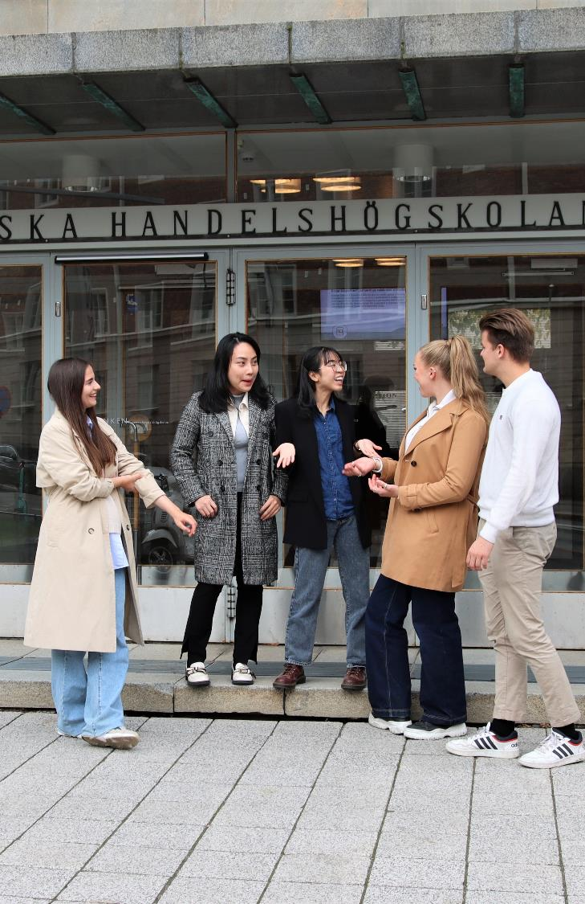
STUDENT EXCHANGE
A term abroad (exchange studies or internship) is included in the Bachelor’s programme.
Each year Hanken sends about 260 exchange students around the world, and welcomes about 220 incoming exchange students to Hanken.
All incoming exchange students are welcomed by Hanken’s committed tutors who provide help and support and arrange social events throughout the term.

Slide 12
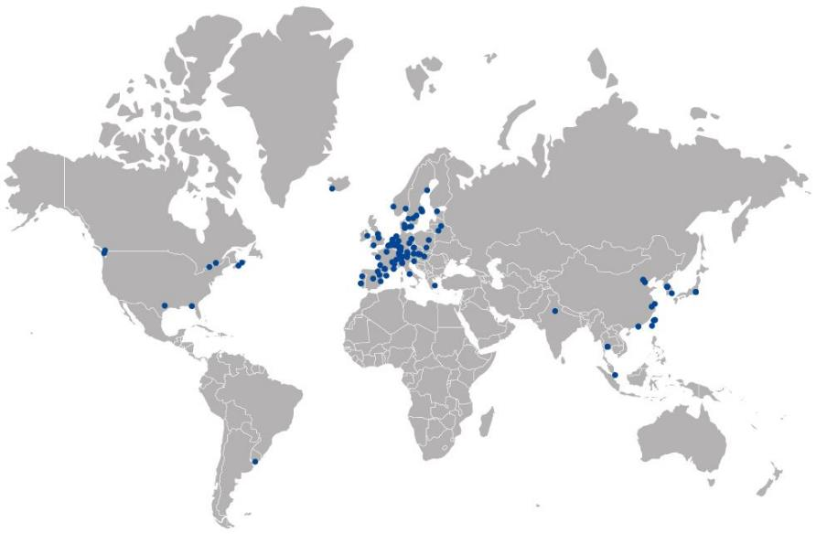
HANKEN’S PARTNER UNIVERSITIES
Hanken has over 130 partner universities in more than 38 countries.
Hanken is active in the Erasmus+ and Nordplus programmes.
Joint Winter School with Lund University, School of Economics and Management .

Slide 13

HANKEN & SSE EXECUTIVE EDUCATION
Hanken & SSE Executive Education – Development for Individuals and Organisations
Hanken & SSE combines academic research with current business practice across three areas:
Organisational Development – Tailored initiatives in strategy, leadership and competence development for management teams, teams and experts.
Individual Programmes – Programmes for professionals who want to develop their leadership skills and strengthen their expertise.
Career Renewal – Support and coaching for organisations and individuals navigating workforce adjustments, organisational change and career transitions.
Hanken & SSE is the executive education company jointly owned by Hanken School of Economics and the Stockholm School of Economics (SSE).

Slide 14

HANKEN EXECUTIVE MBA
STRATEGIC LEADERSHIP
FOR IMPACT
Hanken Executive MBA is a post-degree programme in English in Helsinki.
The flexible part-time programme enables you to grow as a professional, strengthen your business competence, and develop your leadership skills.
Studies can start in March or October and be completed in 1.5, 2, or 2.5 years.
The Hanken Executive MBA is internationally triple-crown accredited (AMBA, AACSB, EQUIS).

Slide 15
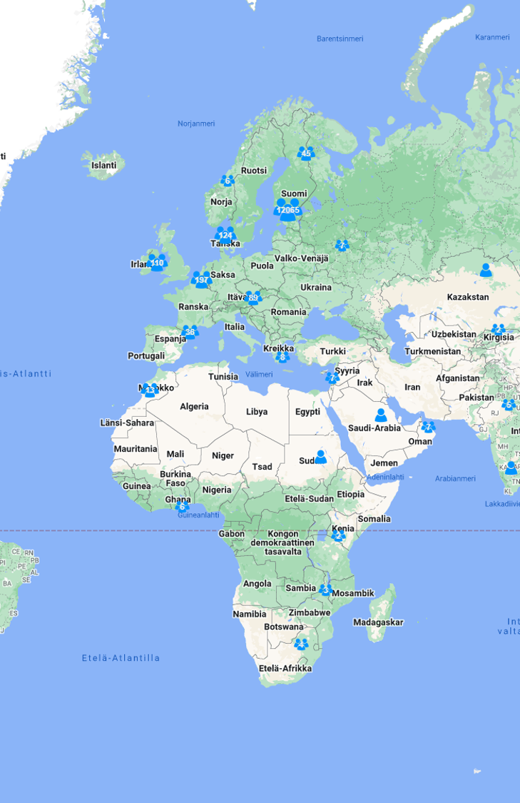
HANKEN ALUMNI
Active alumni network with over 16 000 alumni in around 70 different countries worldwide
Formal activities since around 2004
A Hanken alum is a person with a degree (BSc, MSc, PhD) or an EMBA-diploma from Hanken
97 % of graduates join the alumni community yearly
Active alumni communication
Monthly alumni newsletter
Hanken magazine
Hanken Alumni groups on LinkedIn and Facebook
Alumni can engage through events, mentoring, guest lecturing, donating and much more!

Slide 16
START-UP INCUBATOR
Hanken Business Lab
  Business incubator for entrepreneurs
  Target groups: start-ups, scale-ups, non-profit organisations and individuals
  Wants to help members achieve significant growth

