Slide 2
Introduction to Hanken IT services 2026
Kicka Lindroos
27.8.2026

Slide 3
Hanken IT services
Data protection
&
Data security
Common IT services
&
IT-services for Research
Computers, Phones and Software management
IT services for the library
IT-procurement and license management
Infrastructure
Webb
&
Databases
Media-production / Hanken Studios
IT-services for Teaching & Learning
IT-architecture
Employees:
- 3 Vasa
- 13 Helsinki
Service Desk
IT-support
AV-support
IT-support for
Teaching & Learning
Notes:
We are responsible for maintenance and development of Hanken's IT environment, including operation of networks and servers, user support and e-learning, system development and management of services in education, research and administration.
Hanken's IT Department operates in both Helsinki and Vaasa. 13 employees in Helsinki and 3 in Vaasa.

Slide 4
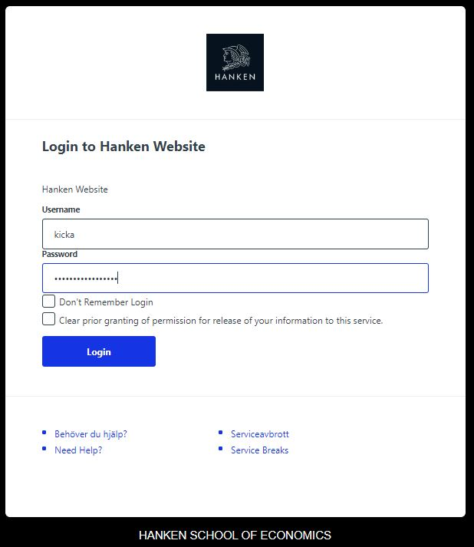
Access control
All IT systems / networks are protected by access control
The IT department need to provide user identity verifications for both the university and our external service providers.
Thus, we are obliged to verify the identity of the users.
  Who the user is→ ID control
  What the user is doing at Hanken-> e.g. study right
  What role the user has-> rights to which systems

Slide 5
YOUR hanken USER-ID ...
Your Hanken user-id is needed nearly everywhere
& is connected to your identity, your personal information
Valid while your study right is active.
Your study right gives your role in the organisation (→exchange student)
→ Your rights in different systems (SISU, Moodle, Exam, Office365…)
Personal – never give your user-id to anybody!
Password a minimum of 12 letters – keep it different from any other accounts´! – Password to be changed at least every 400 day

Slide 6
...YOUR hanken USER-ID ... 3 different forms...
Short: 8-letter-user-id,
ex ”kaliama”
→ ex. SISU, Moodle, EXAM
Long: 8-letter-user-id@student.hanken.fi
ex.” kaliama@student.hanken.fi”
→ Office365 365.hanken.fi
( your e-mail,Microsoft Word, Excel, Teams, OneNote... )
Middle long: 8-letter-user-id@hanken.fi
→ ex. kaliama@hanken.fi
for the wireless network – eduroam

Slide 7
...YOUR hanken USER-ID ... Continued...
Three different forms of your user-id:
User-Id (8 letters) | The most common version in Hanken; your personal Hanken computer and systems like the web, Sisu, Moodle, Exam...
User-Id@hanken.fi | eduroam (WIFI)
User-Id@student.hanken.fi | Microsoft 365 (e-mail, OneNote, Word, Excel, Teams)
 | And many other Finnish systems outside Hanken

Slide 8
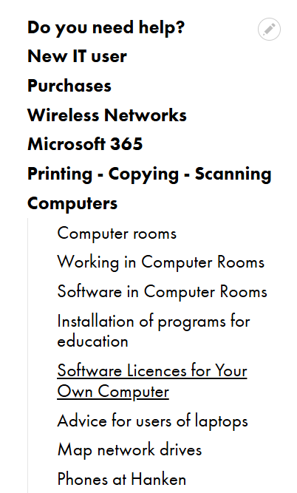
Your OWN computer
You will need your own computer in nearly everything in your studies
General information is found on the web:
https://www.hanken.fi/en/it-services/computers
You can set it up with needed software from Hanken:
(Office365, SPSS, Mathematica,...)
Instructions for using your own computer in an exam (when possible), you find under https://www.hanken.fi/en/students/study-practicalities/digital-site-exams

Slide 9
MULTIFACTOR AUTHENTICATION (MFA)
Multifactor authentication (MFA), also called two-factor authentication (2FA), is a method that improves the security of your Hanken-account
significantly.
Must be activated at the latest 14 days after your first login.
Can be activated either using your mobile number or
mobile app.
More information on how this works and how to activate:
https://go.hanken.fi/mfa-eng

Slide 10
Access to different it-services
Eduroam – wireless network, found in all Finnish universities and all over the world, millions of users
(https://www.hanken.fi/en/it-services/wireless-networks)
MICROSOFT 365 – 50GB e-mail, 1TB Onedrive for Business, Word, Excel.. as cloudtools or full version installed on your own computer. Teams etc
(365.hanken.fi)

Slide 11
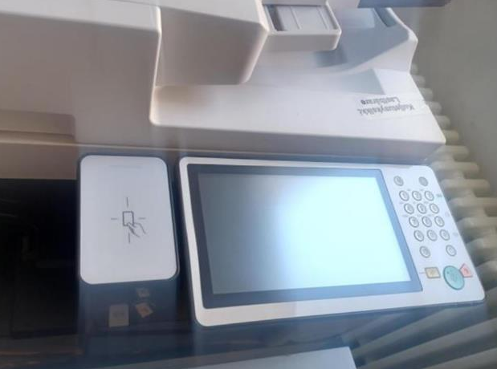
PRINTING/ SCANNING/ COPYING
You can print from any Hanken computer to any printer – use Follow-Me
Printers in Helsinki:
  In the corridor on the 4th floor,
  in the basement in library acquarium
  and Skogen, as well as in the bookstore IB
Printers in Vaasa:
  3rd floor outside computer rooms and
  1st floor main entrance.
Credits for the printers can be bought from the bookstore IB.
Electronic “key” – RFID on your phone, a card, …The first time, show the key to the printer, login manually with your Hanken userid (short) and password.
Next time you only need to show your key to the printer to get access to your printed material.
Read more about the printers and registering the key at
https://www.hanken.fi/en/it-services/printing-copying-scanning

Slide 12
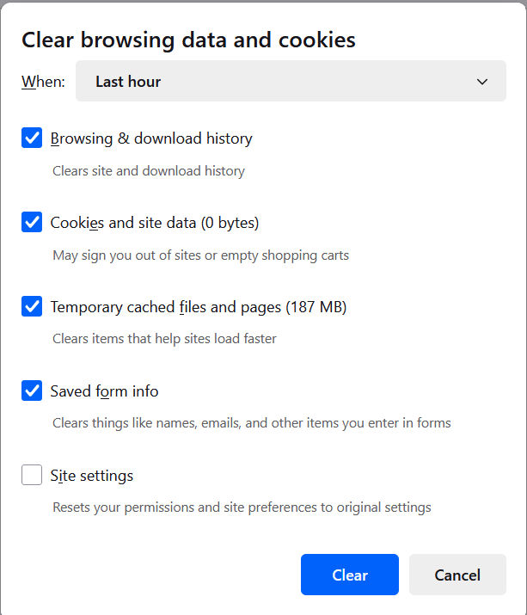
Hanken student computers
On shared computers – logout and empty history
In Helsinki
room A407, 4:th floor
Quantum, 1st floor
Library
In Vaasa
3:rd floor, room v317
Quantum - v325
Software needed for studies is installed on Hanken student computers - for example Microsoft Office, statistics software etc.
In Quantum you can also find some unique finance software installed only on a few computers

Slide 13
Your official hanken e-mail address
givenname.familyname@student.hanken.fi
For your studies, always use your Hanken email:
Teachers and support people can see you belong to Hanken
You get access to services because you are a “Hankeit”
NOTE: you cannot forward your Hanken email!
Your e-mail and your user-id are only for your studies (no business).
Mail is found at 365.hanken.fi
Login: user-id@student.hanken.fi

Slide 14
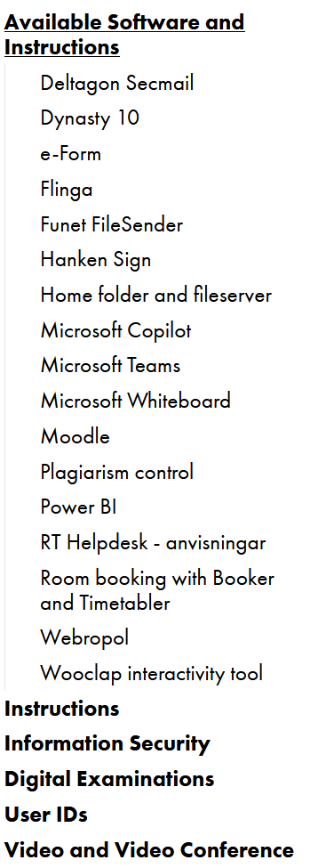
HELP?!
And log in &
Check the web pages!
help@hanken.fi
IT-services on the web:
https://www.hanken.fi/en/it-services/
Lost your password?
➔ selfservice portal with banc codes
Face-to-face service:
  in Helsinki at the student service desk Tuesday & Thursday 11:30-13:00
  in Vaasa at the IT office area at the third floor.
.

