Slide 2
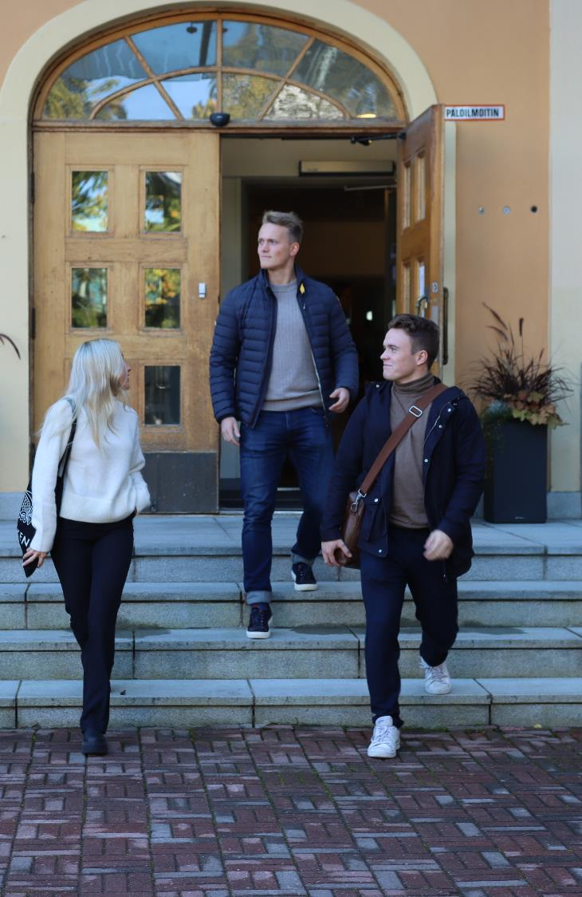
ABOUT HANKEN
Founded in 1909
University status 1927
Comprehensive business school that offers BSc, MSc and PhD in economic sciences as well as executive education (Hanken & Stockholm School of Economics)
Branch set up in Vaasa in 1980
Turnover 27,3 M€ (2024)
Assets 185,9 M€ (2024)
International accreditations: EQUIS, AACSB and AMBA
International rankings: FT Masters in Management (57) and
US News (110)

Slide 3
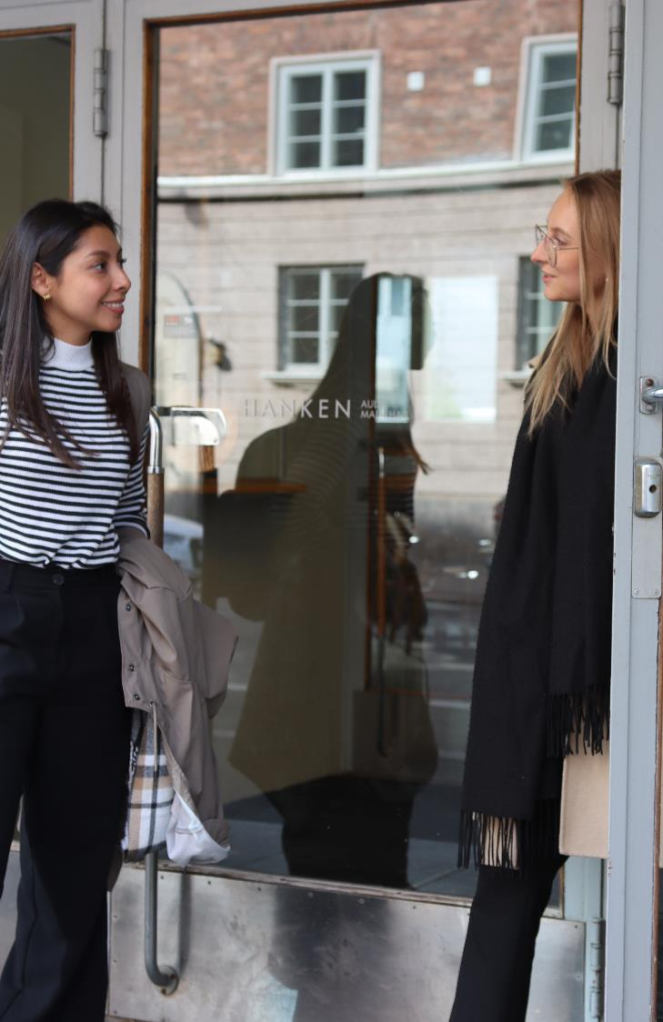
HANKEN TODAY
Teaching in Swedish and English
4 departments and a language centre
2 815 students (2024)
  2 690 BSc and MSc students
  125 PhD students
  20% in Vaasa
307 employees (2023)
Finland´s only free-standing business school

Slide 4

RECENT DEVELOPMENTS
Global ranking
  Financial Times, Masters in Management: #57 (2024)
Education
  Record number of applications in 2024 (all levels)
  New BSc in Business program (in English) starting in 2024 with 80 students chosen among 1376 applicants
Research
  Highest scientific impact (‘top 10 index’) of the Finnish universities (Academy of Finland, 2023)
ENGAGE.EU
  Hanken full member of the EU university alliance since November 1, 2023 with 8 other leading universities and business schools

Slide 5

HANKEN STRATEGY 2030:
FOR AN INTERNATIONAL FINLAND
AND A SUSTAINABLE WORLD
VISION
An increasingly highly regarded international business school contributing to the future of business and society.
MISSION
Collaborating closely with business and society, Hanken is a research-driven business school that foster responsible professionals to drive a sustainable future.
Being a stand-alone business school with strong Nordic roots, we offer high-quality degree programmes in Swedish and English.
VALUES
Our community is characterised by equity, openness and integrity, and a focus on high quality, continuous improvement,
and sustainability.

Slide 6
RESEARCH AND COMPETENCE CENTRES
The centres are linked to the departments at Hanken and work in close contact with the business community.
CCR | Centre for Corporate Responsibility
CERS | Centre for Relationship Marketing and Service Management
EPCE | Erling-Persson Centre for Entrepreneurship
GODESS | Gender, Organisation Diversity, Equality and Social Sustainability in Transnational Times
 | Hanken Centre for Accounting, Finance and Governance
Helsinki GSE | Helsinki Graduate School of Economics
HUMLOG Institute | The Humanitarian Logistics and Supply Chain Research Institute
IPR University Centre | Centre for Intellectual Property Rights
WCEFIR | Wallenberg Centre for Financial Research

Slide 7

ACADEMIC PROGRAMMES
Integrated Bachelor’s and Master’s degree programme (3+2 years)
  Swedish main language of tuition
  Enrolment approximately 300 new students/year
  Bachelor in Business programme in English will begin in 2024, 80 study spots.
Master’s programme (2 years)
  Tuition in Swedish and English
  Enrolment approximately 140 students/year
PhD programme (4 years)
  Tuition mainly in English
  Goal: 14 PhD degrees awarded per year

Slide 8
SUBJECTS
Major subjects
Accounting
Commercial Law
Economics
Entrepreneurship, management and organisation
Finance
Management and organisation
Marketing
Supply chain management and social responsibility (master’s and PhD level only)
Other subjects
Information systems science
Statistics
Languages
Swedish
Finnish
English
French
German
Russian
Spanish

Slide 9
THE MASTER’S PROGRAMME OFFER:
More information:
www.hanken.fi/masters
Accounting
Economics
Finance
Intellectual Property and Business Law
International Strategy and Sustainability
Marketing
Supply Chain Management
Marketing and Management (Vaasa)

Slide 10

MASTER’S DOUBLE DEGREE PROGRAMME
Master’s Double Degree Programme in Sustainability Reporting and Financial Analysis together with Umeå University
The Double Degree programme includes one semester at Umeå University in Umeå, Sweden and one semester at Hanken in Vaasa, Finland

Slide 11
MASSIVE OPEN ONLINE COURSE (MOOC)
Hanken offers globally accessible courses that are free and open to all. Hanken's course offerings include MOOCs on topics such as service research, logistics and sustainable development.
Hanken offers MOOCs on the FutureLearn platform. Course participants can access short lectures, articles, discussions and tests remotely. All course material is adapted for use on both mobile devices and computers.
For questions about Hanken's MOOCs,
please contact Teaching Lab: teachinglab@hanken.fi.

Slide 12
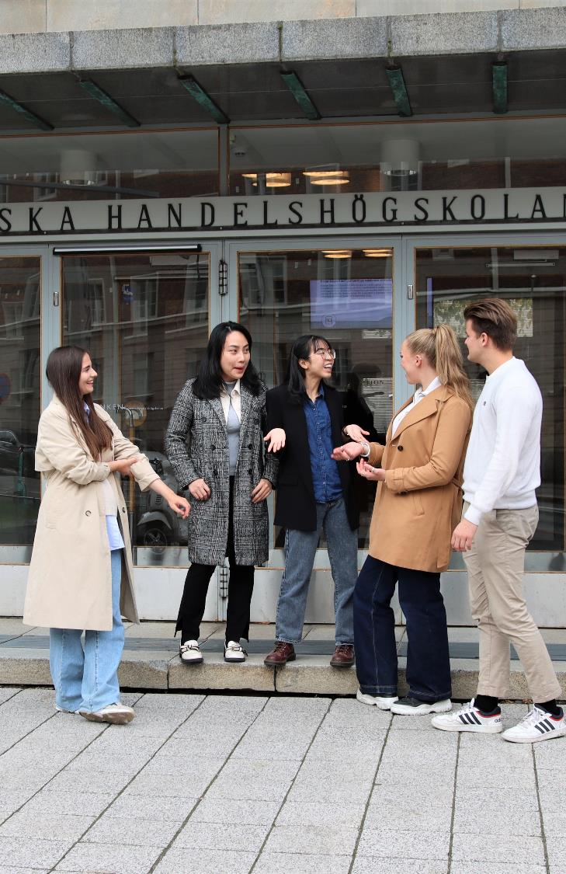
STUDENT EXCHANGE
A term abroad (exchange studies or internship) is included in the Bachelor’s programme.
Each year Hanken sends about 260 exchange students around the world, and welcomes about 220 incoming exchange students to Hanken.
All incoming exchange students are welcomed by Hanken’s committed tutors who provide help and support and arrange social events throughout the term.

Slide 13
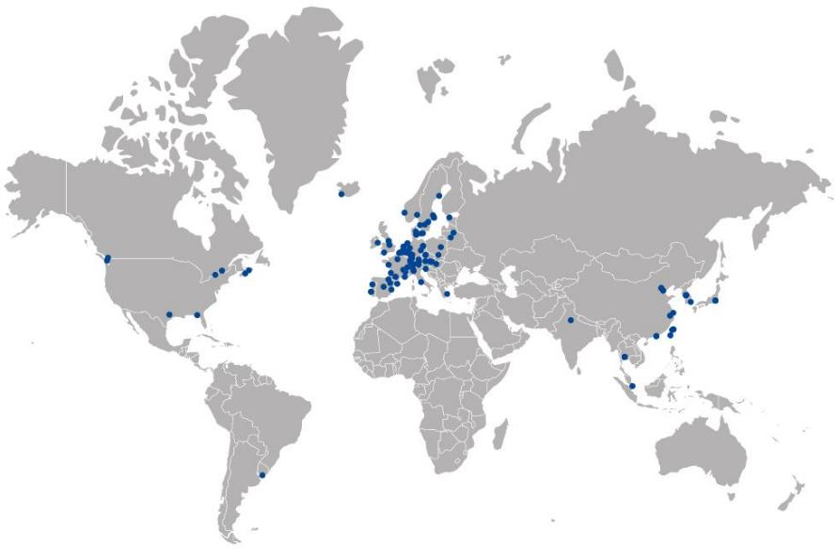
HANKEN’S PARTNER UNIVERSITIES
Hanken has over 130 partner universities in more than 38 countries.
Hanken is active in the Erasmus+ and Nordplus programmes.
Joint Winter School with Lund University, School of Economics and Management .

Slide 14
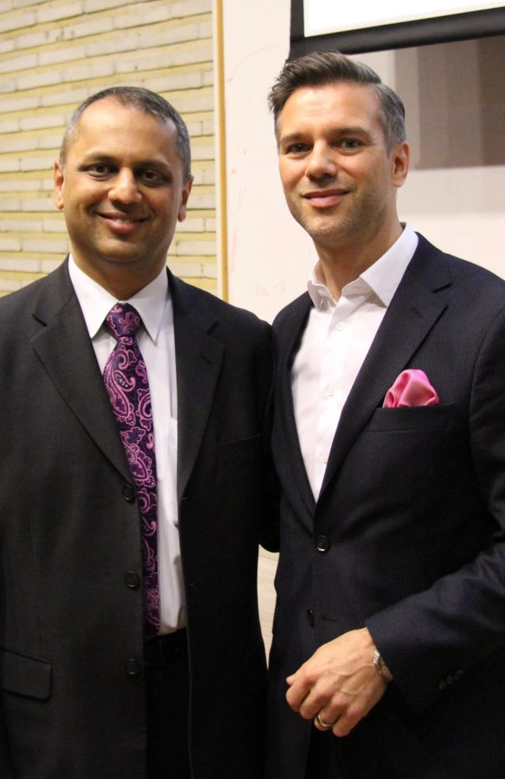
HANKEN & SSE EXECUTIVE EDUCATION
Transforms academic research and the latest business insight into impact in practice to accelerate the growth and renewal of people and organisations.
Offers top-quality development solutions in areas such as strategic renewal, leadership and competence development to leaders, management teams, teams and experts worldwide.
Supports and coaches organisations and individuals in workforce adjustment and change situations.
Owned by Hanken and Stockholm School of Economics (SSE).

Slide 15

HANKEN EXECUTIVE MBA
STRATEGIC LEADERSHIP
FOR IMPACT
Hanken Executive MBA is a post-degree programme in English in Helsinki.
The flexible part-time programme enables you to grow as a professional, strengthen your business competence, and develop your leadership skills.
Studies can start in March or October and be completed in 1.5, 2, or 2.5 years.
The Hanken Executive MBA is internationally triple-crown accredited (AMBA, AACSB, EQUIS).

Slide 16
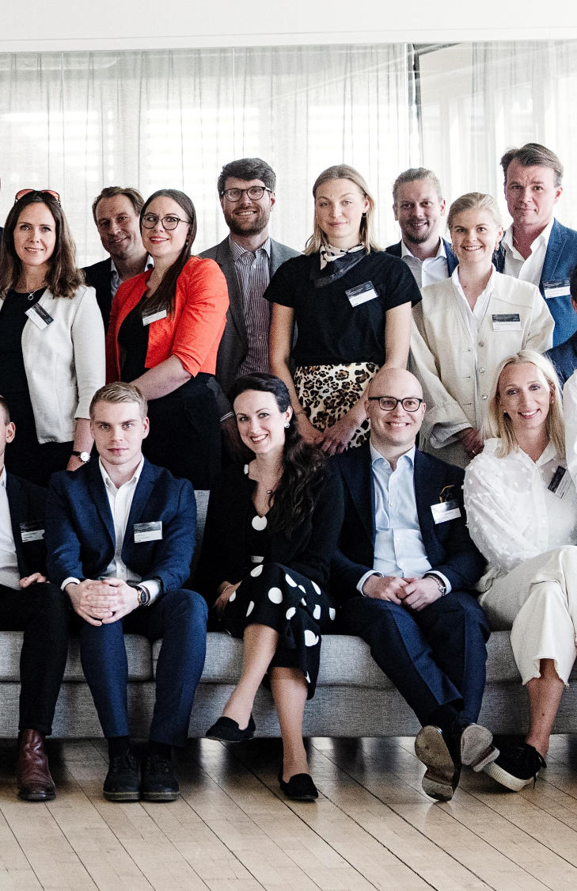
HANKEN ALUMNI
16 000 alumni in 70 countries worldwide
Committed alumni network
Approximately 10 alumni events yearly in Helsinki and Vaasa
  Homecoming day ”Hankendagen” (Helsinki and Vaasa)
  International homecoming days (Stockholm, London, Brussels, Zürich, Berlin)
More than 70 mentors sign up annually to guide students and recent graduates
Active communication
  Monthly alumni newsletter
  Hanken magazine
  Hanken Alumni groups on Facebook and LinkedIn

Slide 17
START-UP INCUBATOR AND QUANTUM
Hanken Business Lab
  Pre-business incubator The Playground
  Business incubator for entrepreneurs
  Target groups: start-ups, scale-ups, non-profit organisations and individuals
  Wants to help members achieve significant growth
Quantum
  Data lab focusing on data-driven value creation
  Databases with company data and financial data
  Management of big data and alternative data

