Slide 2
IT Services at Hanken
ICT coordinator Kicka Lindroos
16 January 2025

Slide 3

1. HANKEN IT SERVICES
We are responsible for maintenance and development of Hanken's IT environment, including operation of networks and servers, user support and e-learning, system development and management of services in education, research and administration.
Hanken's IT Department operates in both Helsinki and Vaasa. 12 employees in Helsinki and 5 in Vaasa.

Slide 4
1.1 IT SERVICES – RESPONSIBILITY AREAS
Data protection
&
Data security
Common IT services
&
IT-services for Research
Computers, Phones and Software management
IT services for the library
IT-procurement and license management
Infrastructure
Webb
&
Databases
Media-production / Hanken Studios
IT-services for Teaching & Learning
IT-architecture
Service Desk
IT-support
AV-support
IT-support for
Teaching & Learning

Slide 5
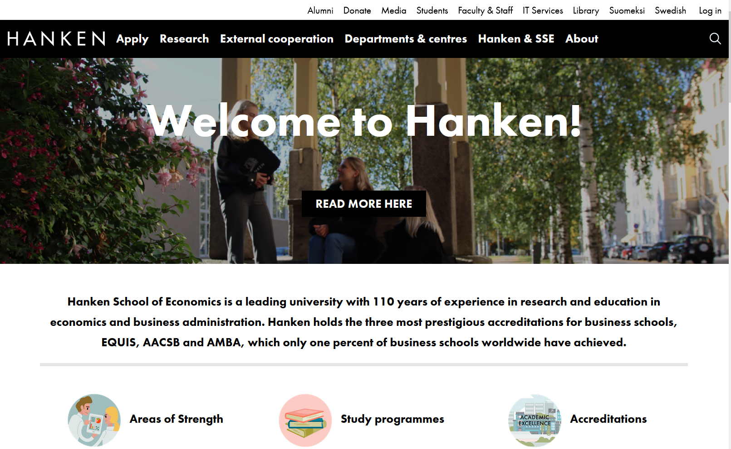
2.1 HANKEN WEBPAGES AND MYWEB
1
Login!
2
IT-services

Slide 6
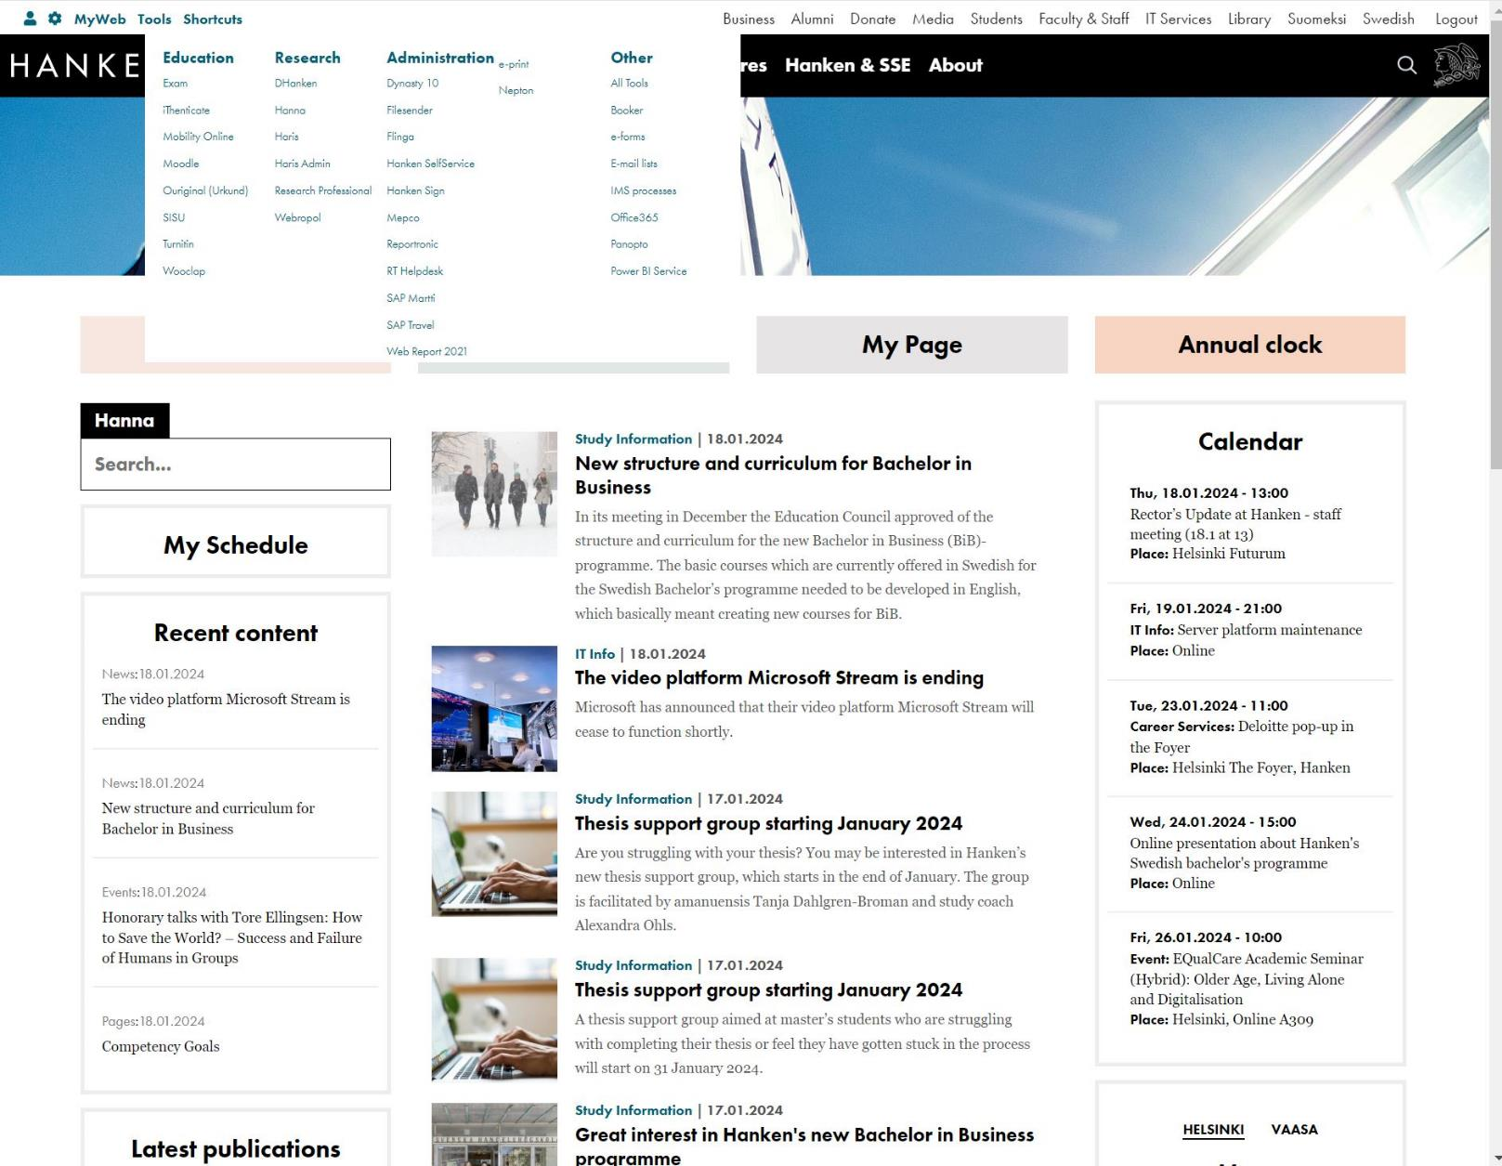
2.1 HANKEN WEBPAGES AND MYWEB
2
1
MyWeb & Tools
Login- Logout!
IT-services
3

Slide 7
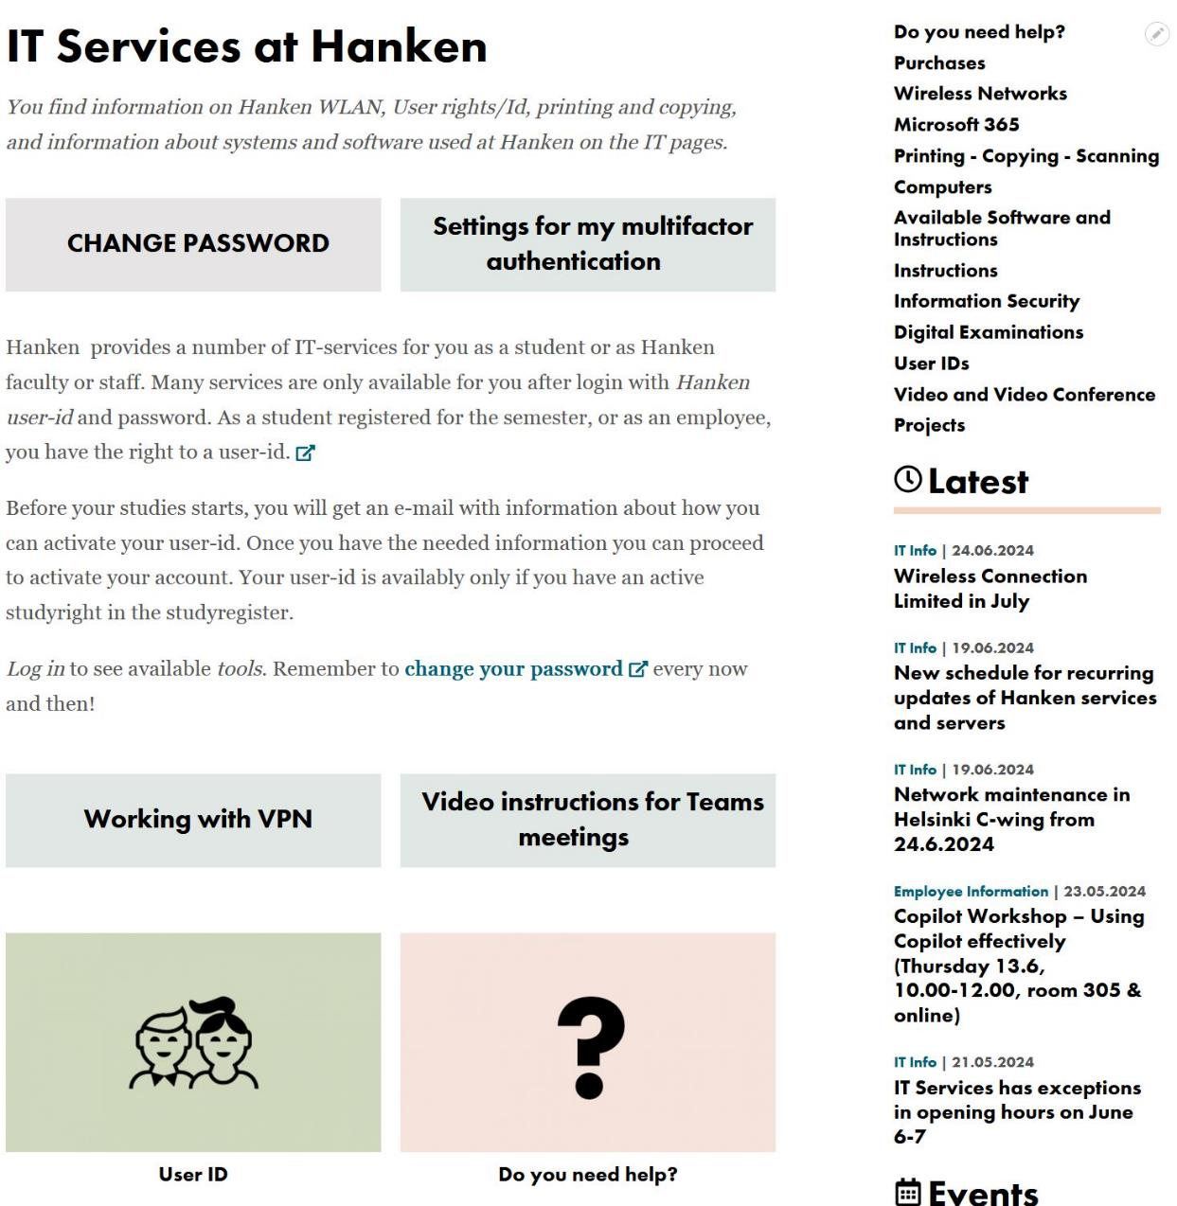




2.2 WWW.HANKEN.FI/EN/IT-SERVICES
Login to see tools, links, information aimed at you!
Instructions for various systems
Latest IT news
Latest IT Calendar

Slide 8
2.3 IT IN YOUR STUDIES
During your time studying at Hanken, you will use several different tools and resources. Below a list of some of the most important ones:
  SISU –administrative study system (registrations and information, courses, exams, course schedules, certifications…)
  Moodle – Learning platform; course material, tasks and discussions, exams
  Exam – Tool for digital exams in Examinarium
  HANNA – E-books, articles and library services.
  EDUROAM – wireless network
  Papercut Mobility Print – printing, scanning and copying
  Microsoft 365 – mail, MS Office, Teams and OneDrive.
https://www.hanken.fi/en/tools-list

Slide 9
2.4 Student computers at Hanken
In Helsinki
room A407, 4:th floor
Quantum, 1st floor
Library
In Vaasa
3:rd floor, room v317
Quantum - v325
Software for your own computer
(via Campus licence):
Microsoft Office – via Microsoft 365,
Statistics software (SPSS, Oxmetrics)
F-secure
  Safe: 5€/year
  Total: 15€/year
Software needed for studies is installed on Hanken student computers - for example Microsoft Office, statistics software etc.
In Quantum you can also find some unique finance software installed only on a few computers
More information: IT-services- Computers

Slide 10
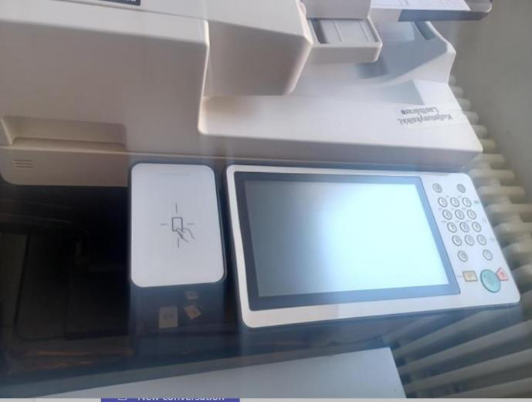
2.5 PRINTING/ SCANNING/ COPYING
You can print from any Hanken computer to any printer – use Follow-Me
Printers in Helsinki:
  In the corridor on the 4th floor,
  in the basement in library acquarium
  and Skogen, as well as in the bookstore IB
Printers in Vasa:
  3rd floor outside computer rooms and
  1st floor main entrance.
Credits for the printers can be bought from IB.
Electronic key – The first time, show the key to the printer, login manually with your Hanken userid and passwd, when that is done, thereafter you only need to show your key to the printer to get access to your printed material.
Read more about the printers and registering the key at
https://www.hanken.fi/en/it-services/printing-copying-scanning

Slide 11
2.6 WIRELESS NETWORK AND PRINTING FROM YOUR OWN COMPUTER
eduroam
You can access WiFi at Hanken and many other universities and places using the eduroam network:
- login with: userid@hanken.fi
Mobility print
Printing from your own computer can be done with mobility print – install it on your computer
More information on wireless networks:
IT-services – Wireless networks
More about the printers and registering the key at
https://www.hanken.fi/en/it-services/printing-copying-scanning

Slide 12
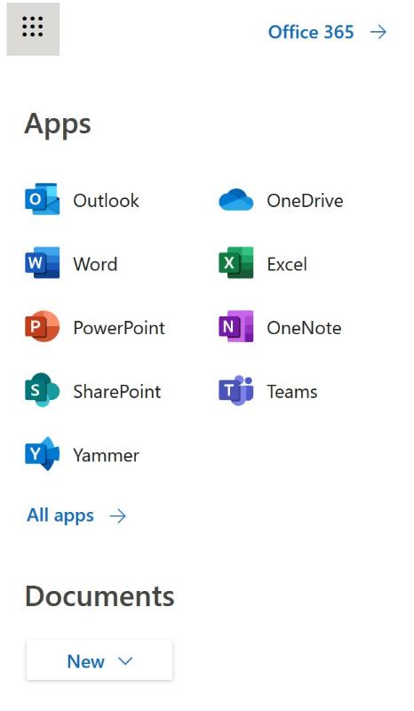
2.7 MICROSOFT 365
Microsoft cloud services:
50 GB e-mail
1 TB on Hankens OneDrive for Business, easy to share documents and work together
Cloud tools like Word and Excel etc, have the basic functions but not all.
Possibility to download a full version of Word, Excel, Powerpoint etc to you own computer
Teams – much used in teaching for groupwork, meetings and distance teaching

Slide 13
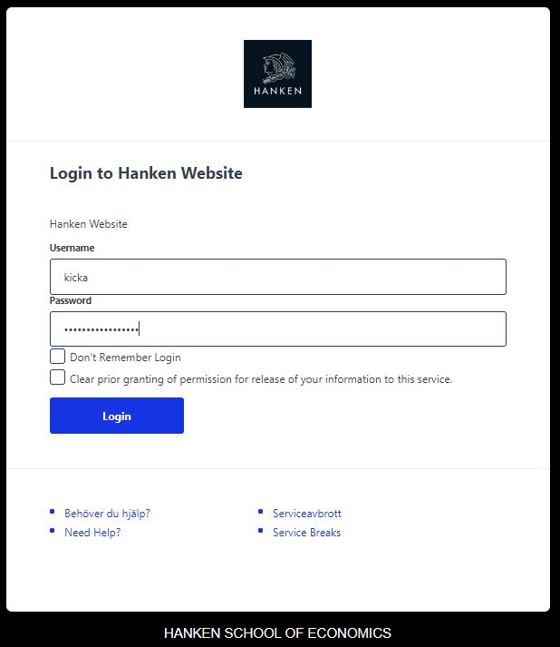
3 ACCESS CONTROL
All IT systems / networks are protected by access control
The IT department need to provide user identity verifications for both the university and our external service providers.
Thus, we are obliged to verify the identity of the users.
  Who the user is→ ID control
  What the user is doing at Hanken-> e.g. study right
  What role the user has-> rights to which systems
Summary: We keep track of who the user is, guarantee that the user is who he claims to be, and grant, on the basis of that, the rights to which the person is entitled

Slide 14

3.1 YOUR USER-ID
YOURS!
– Personal!
– Your responsibility!
- For your studies!
Valid while you are registered as studying at Hanken.
Different forms of your user-id:
the most common version – to Sisu, Moodle, Exam, … | user-id
eduroam (WiFi) | user-id@hanken.fi
Microsoft 365 (e-mail, onenote, office software...) | user-id@student.hanken.fi
  ––
  –
The password is valid for 400 days
➔Never use the same password at Hanken that you
use elsewhere!
On shared computers – log out!
Don´t save passwords in the browser´s memory.
Your email address and username are two different things!
At Hanken you always use your user-ID as your login name!
Read more:
https://www.hanken.fi/en/it-services/user-ids/validity-user-id

Slide 15

3.2 YOUR OFFICIAL HANKEN E-MAIL
givenname.familyname@student.hanken.fi
login with
user id@student.hanken.fi
Mail is found via Outlook or online at 365.hanken.fi
Only for your studies at Hanken
Valid as long as
your studyright at Hanken is active
Always use your Hanken email in communication regarding your studies with teachers and support people.
Read more: https://www.hanken.fi/en/it-services/microsoft-365/email

Slide 16

3.3 Take care of your credentials
  We never ask for your password!
  An IT administrator never asks for your password
  - he has no right to know it!
  NEVER give out user ID and password in an email!
  = never reply / never click on links in emails you do not expect to receive
  Data security is presented in more detail in a later lecture
  If you suspect that your account has been compromised,
  please contact help@hanken.fi as soon as possible!
Read more: https://www.hanken.fi/en/it-services/information-security

Slide 17
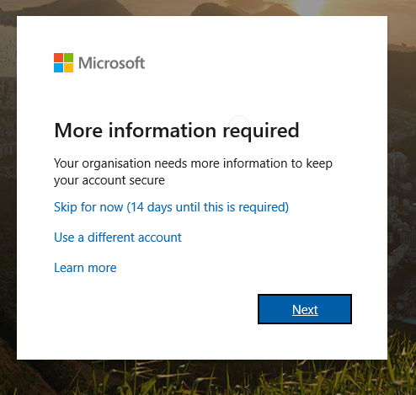
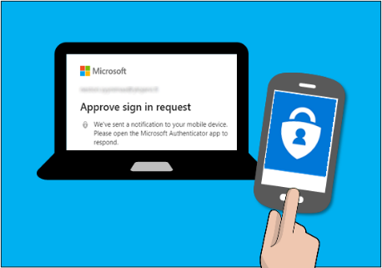
3.4 MULTIFACTOR AUTHENTICATION (MFA)
Multifactor authentication (MFA), also called
two-factor authentication (2FA), is a method that
improves the security of your Hanken-account
significantly.
Must be activated latest 14 days after your first login.
Can be activated either using your mobilenumber or
mobile app.
More information on how this work and how to activate:
https://go.hanken.fi/mfa-eng

Slide 18
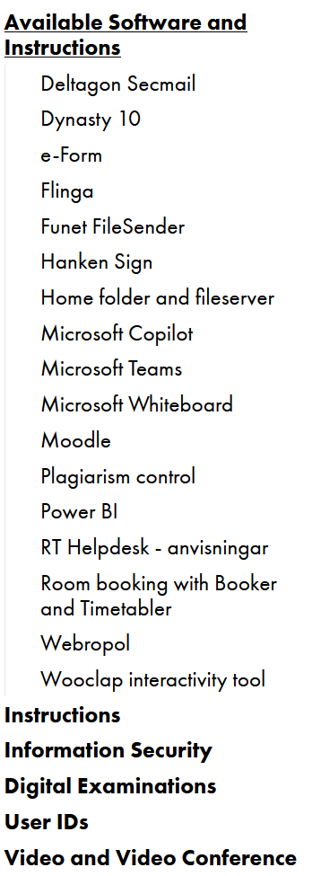
HELP?!
help@hanken.fi
IT-services on the web:
https://www.hanken.fi/en/it-services/do-you-need-help
Lost your password?
➔ go to IT Services
Face-to-face service:
  in Helsinki at the student service desk Tuesday – Thursday 11:30-13:00
  in Vaasa at the IT office area at the third floor.
.
Check the web pages!
And log in!

Slide 20
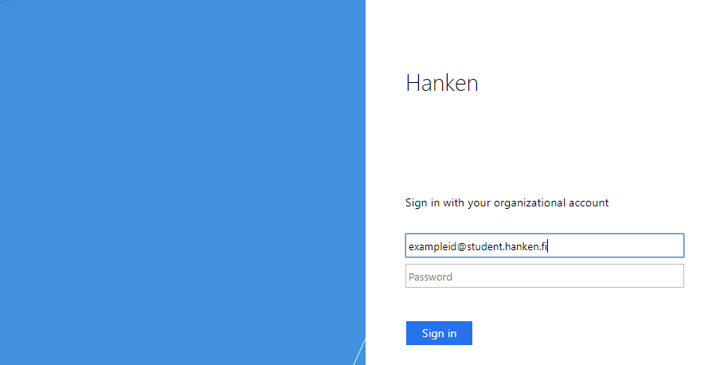
3.1 YOUR USER-ID, CONT.
Different forms of your user-id:
  user-id – the most common version (shibboleth)
  user-id@hanken.fi – eduroam (WiFi)
  user-id@student.hanken.fi
  – Microsoft 365 (e-mail, onenote, office software...)

