Slide 2
IT Services at Hanken
Datacentralen
Kicka Lindroos – ICT coordinator

Slide 3
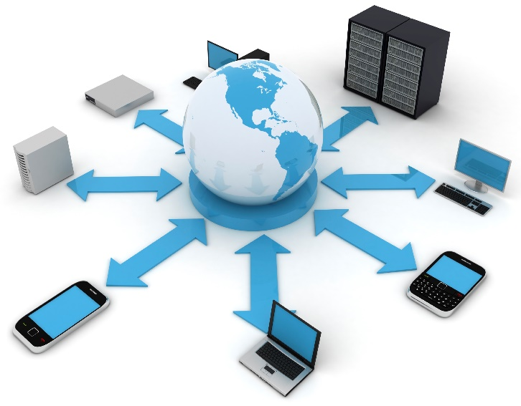

1. Hanken IT - Datacentralen
Hanken's IT Department operates in both Helsinki and Vaasa. Right now, there are 12 of us in H:ki and 3 in Vaasa.
We are responsible for maintenance and development of Hanken's IT environment, including operation of networks and servers, user support and e-learning, system development and management of services in education, research and administration.

Slide 4
1.1 IT Services – Responsibility areas
Data protection
&
Data security
Common IT services
&
IT-services for Research
Computers, Phones and Software management
IT services for the library
IT-procurement and license management
Infrastructure
Webb
&
Databases
Media-production / Hanken Studios
IT-services for Teaching & Learning
IT-architecture
Service Desk
IT-support
AV-support
IT-support for Teaching & Learning

Slide 5
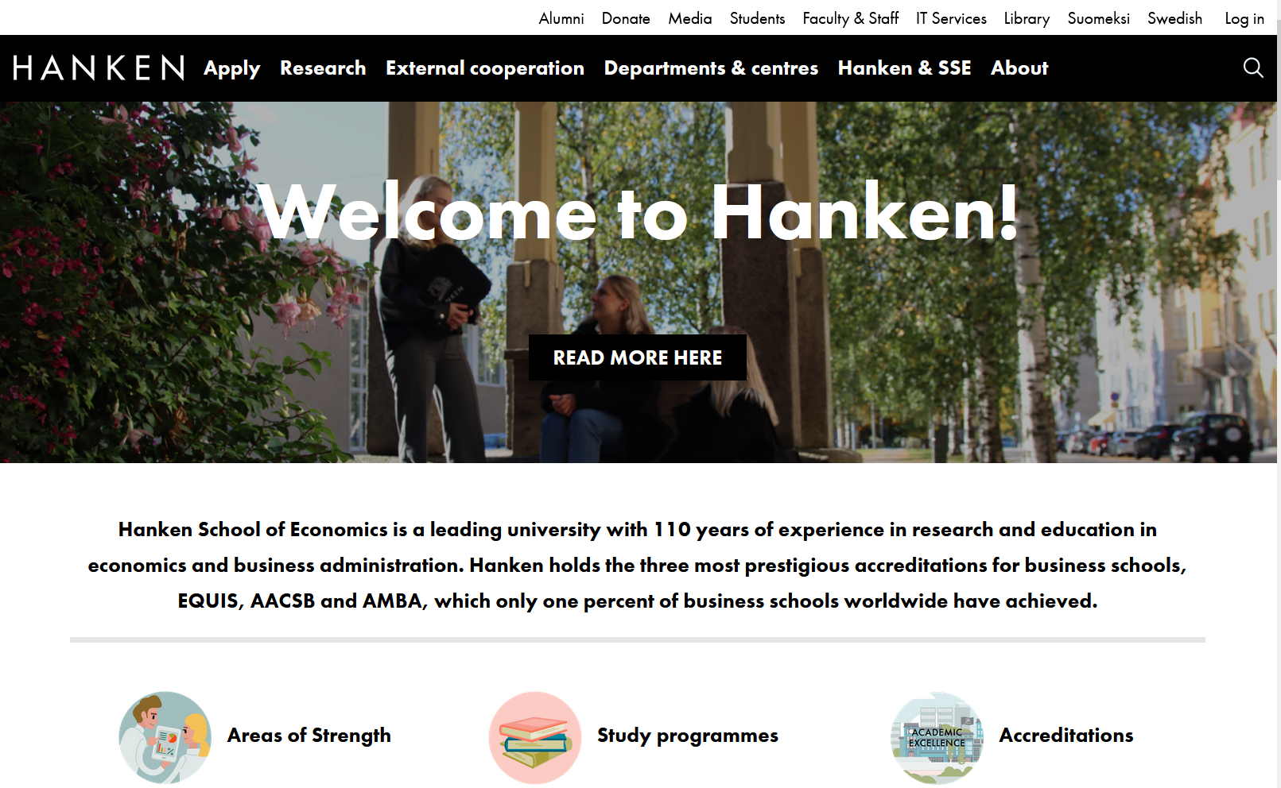
2.1 Hanken Webpages and MyWeb
Login!
1
IT-services
2

Slide 6
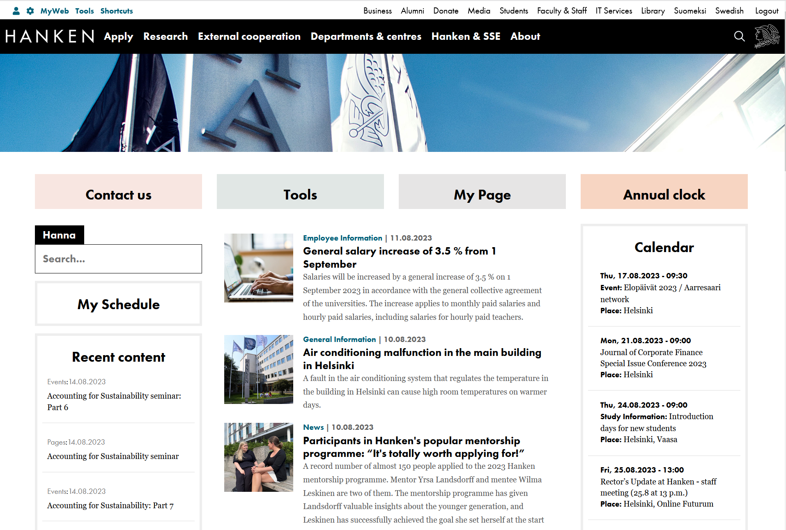
2.1 Hanken Webpages and MyWeb
2
Login- Logout!
MyWeb & Tools
1
IT-services
3

Slide 7
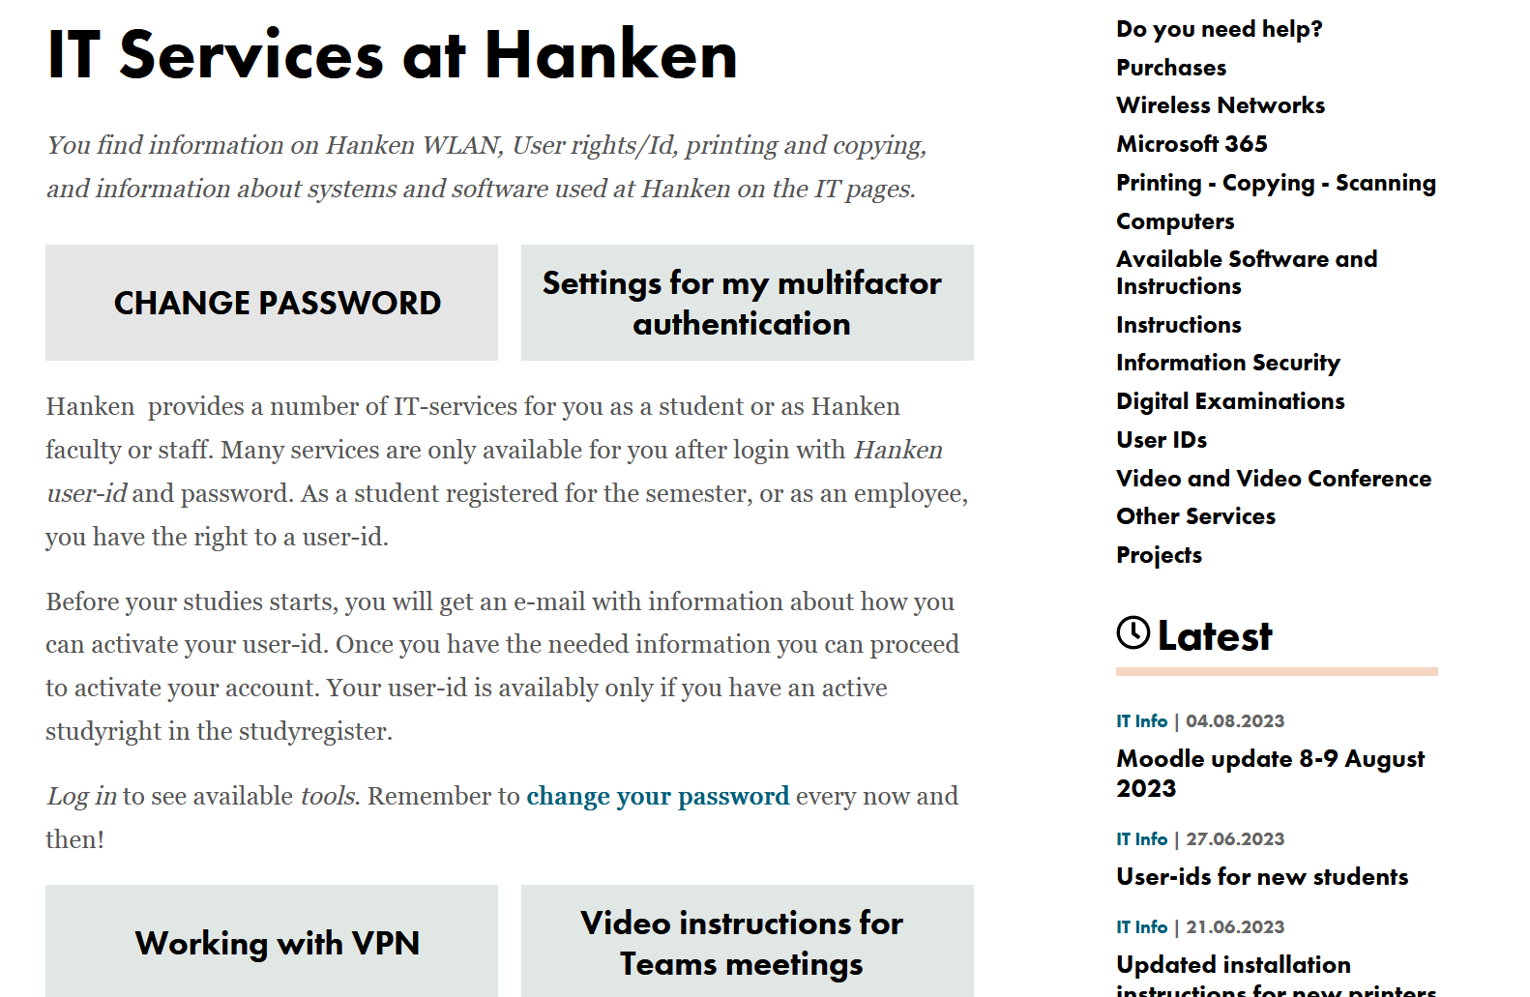




2.2 www.hanken.fi/en/It-services
Login to see tools, links, information aimed at you!
Instructions for various systems
Latest IT news
Latest IT Calendar

Slide 8
2.3 IT in your studies
During your time studying at Hanken, you will use several different tools and resources. Below a list of some of the most important:
  SISU – Course description, course registration and course evaluation
  Moodle – Learning platform; course material, tasks and discussions, exams
  Exam – Tool for digital exams in Examinarium
  HANNA – E-books, articles and library services.
  EDUROAM – wireless network
  Papercut Mobility Print – printing, scanning and copying
  Microsoft 365 – mail, MS Office, Teams and OneDrive.
https://www.hanken.fi/en/tools-list

Slide 9
2.4 Student computers at Hanken
In Helsinki
room A407, 4:th floor
Quantum, 1st floor
Library
In Vaasa
3:rd floor, room v317
Quantum - v325
Software for your own computer
(via Campus licence):
Microsoft Office – via Microsoft 365,
Statistics software (SPSS, Oxmetrics)
F-secure
  Safe: 5€/year
  Total: 15€/year
Sofware needed for studies is installed on Hanken student computers - for example Microsoft office, statistics software etc.
In Quantum you can also find some unique finance software installed only on a few computers
More information: IT-services- Computers

Slide 10
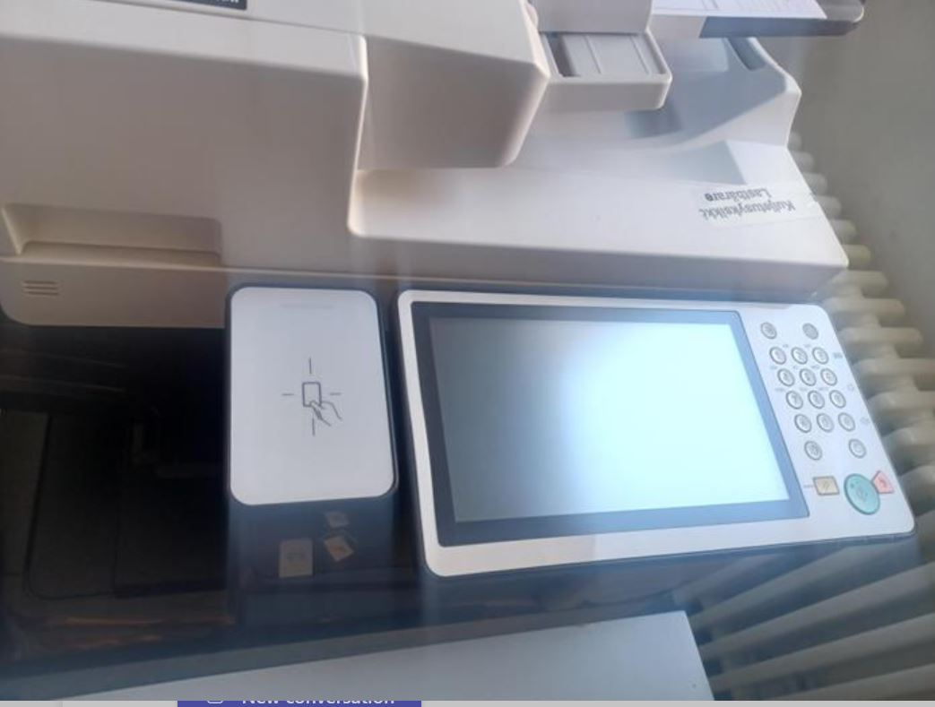
2.5 Printing/ Scanning/ Copying
You can print from any Hanken computer to any printer – use Follow-Me
Printers in Helsinki:
  In the corridor on the 4th floor,
  in the basement in library acquarium and Skogen as well as
  in IB (book store)
Printers in Vasa:
  3rd floor outside computer rooms and
  1st floor main entrance.
Credits for the printers can be bought from IB.
Electronic key –
The first time, show the key to the printer, login manually with your Hanken userid and passwd, when that is done, thereafter you only need to show your key to the printer to get access to your printed material.
Read more about the printers and registering the key at
https://www.hanken.fi/en/it-services/printing-copying-scanning

Slide 11
2.6 Wireless network
eduroam
You can access WiFi at Hanken and many other universities and places using the eduroam network:
- login with: userid@hanken.fi
More information:
it-services – wireless networks
Mobility print
Printing from your own computer can be done with mobility print – install it on your computer

Slide 12
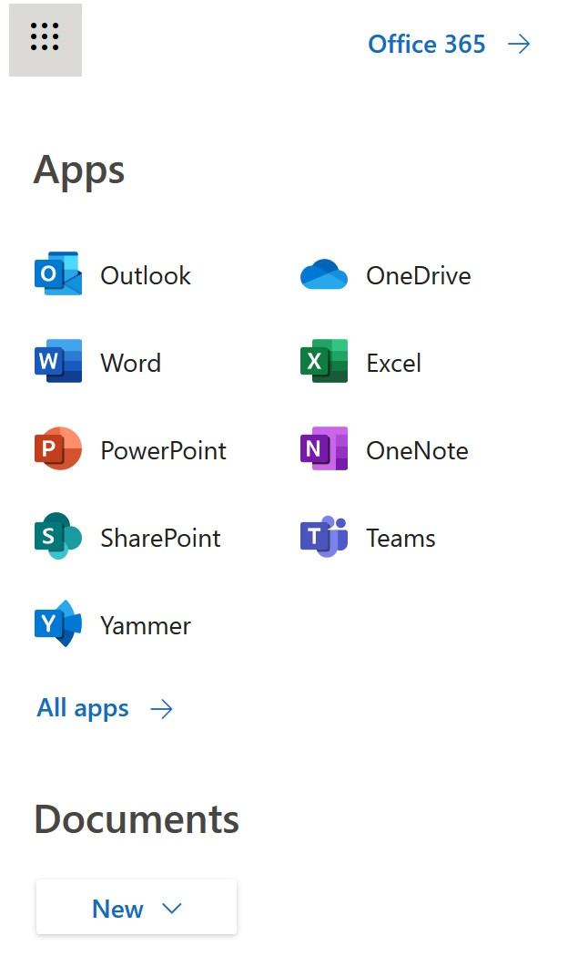
2.7 Microsoft 365
Microsoft cloud services:
50 GB e-mail
1 TB on OneDrive
File sharing
Cloud tools like Word and Excel etc, - cloud tools do not have all features
Teams
Office tools on your own computer

Slide 13
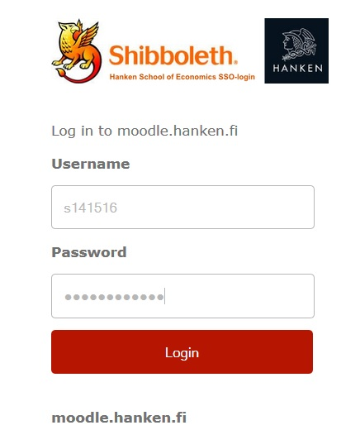
3 Access control
All IT systems / networks are protected by access control
The IT department need to provide user identity verifications for both the university as well as for our external service providers.
Thus, we are obliged to verify the identity of the users.
  Who the user is→ ID control
  What the user is doing at Hanken-> e.g. study right
  What role the user has-> rights to which systems
Summary: We keep track of who the user is, guarantee that the user is who he claims to be and grant on the basis of that the rights to which the person is entitled

Slide 14

3.1 Your User-ID
YOURS! – Personal! – Your responsibility! - For studies!
Valid while you are studying at Hanken
The Password is valid for 400 days
➔Never use the same password at Hanken that you use elsewhere!
On shared computers – log out! Don´t save passwords in
the browser memory.
Read more: https://www.hanken.fi/en/it-services/user-ids/validity-user-id

Slide 15
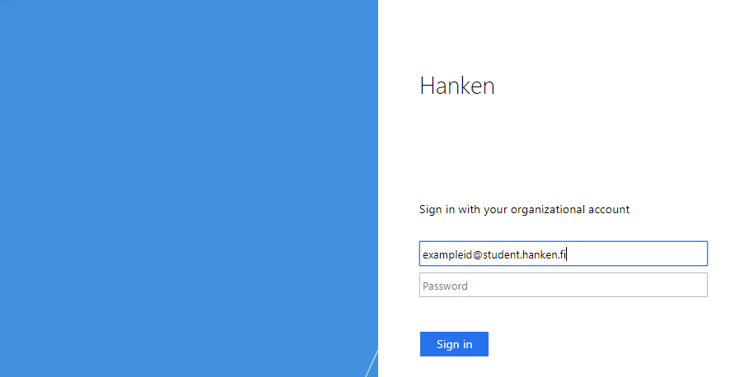
3.1 Your User-ID, cont.
Different forms of your user-id:
  user-id – the most common version (shibboleth)
  user-id@hanken.fi – eduroam (WiFi)
  user-id@student.hanken.fi
  – Microsoft 365 (e-mail, onenote, office software...)
  Your email address and username is two
  different things. You always use your
  username as you login name!

Slide 16
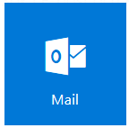
3.2 Your official Hanken e-mail
givenname.familyname@student.hanken.fi
Valid as long as your studyright at Hanken is active
for your studies at Hanken only.
Always use it in communication regarding your studies.
Mail is found via Outlook or online at 365.hanken.fi
login with user-id@student.hanken.fi
Read more: https://www.hanken.fi/en/it-services/microsoft-365/email

Slide 17
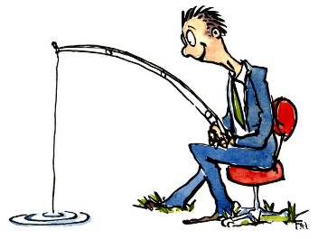
3.3 Fishing warning
  We never ask for your password!
  An IT administrator never asks for your password - he has no right to know it.
  NEVER give out user ID and password in an email!
  = never reply / never click on links in emails you do not expect to receive
  Data security is presented in more detail in the next section!
  If you suspect that your account has been compromised,
  please contact help@hanken.fi as soon as possible!
Read more: https://www.hanken.fi/en/it-services/information-security

Slide 18
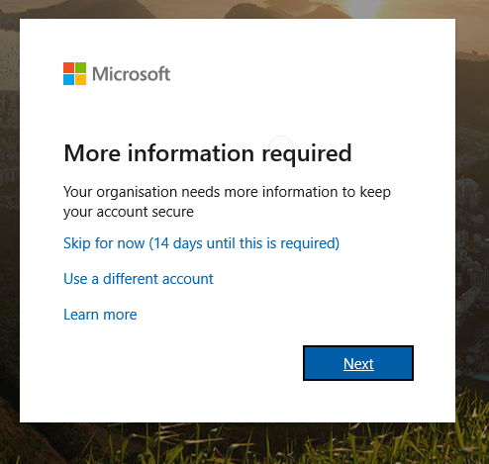
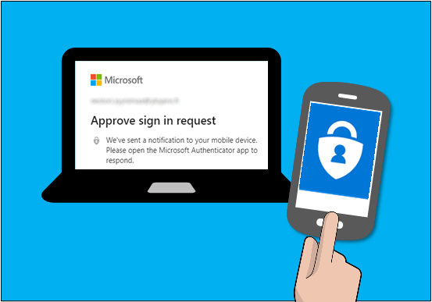
3.4 Multifactor authentication (MFA)
Multifactor authentication (MFA), also called two-factor
authentication (2FA), is a method that improves the security
of your Hanken-account significantly.
Must be activated latest 14 days after your first login.
Can be activated either using your mobilenumber or mobile app.
More information on how this work and how to activate:
https://go.hanken.fi/mfa-eng
Notes:
Flerfaktorsautentisering (MFA), även kallad tvåfaktorsautentisering (2FA), är en metod som avsevärt förbättrar säkerheten för ditt Hanken-konto. I praktiken betyder det att du bekräftar inloggningar med telefonen, vilket betyder att någon som stulit ditt lösenord inte kan logga in.

Slide 19
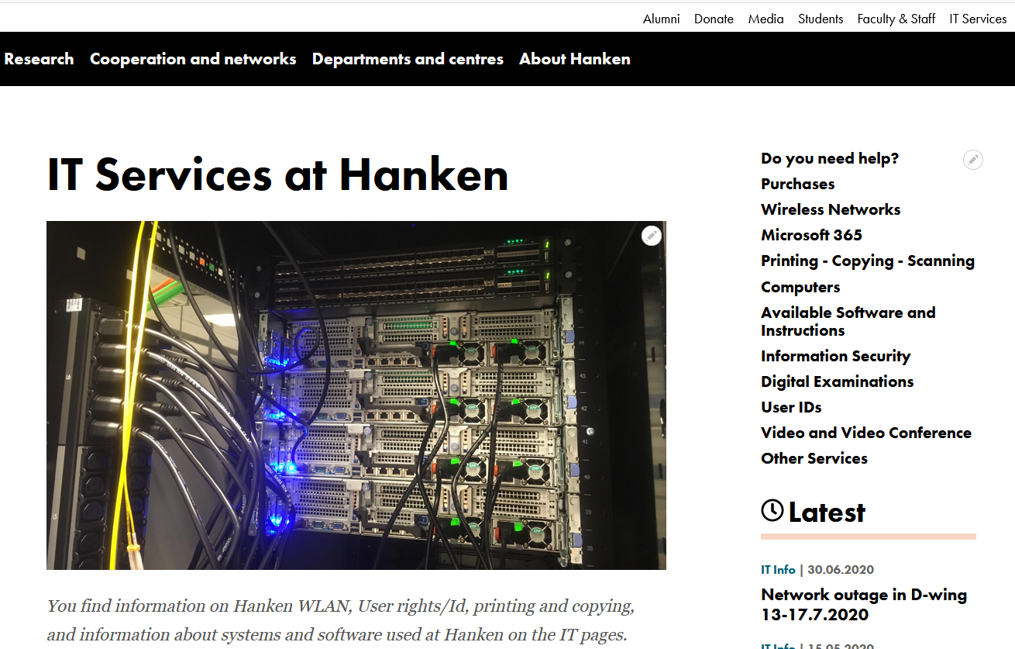
HELP?!
help@hanken.fi
IT-services at the web:
https://www.hanken.fi/en/it-services/do-you-need-help
Lost your password?
➔ go to IT Services
Face-to-face service:
  in Helsinki at the student service Tuesday – Thursday 11:30-13:00 or in the IT office at the second floor.
  in Vaasa at the IT office area at the third floor.
.

